Slide 1
BT201
Biochemical Process Calculations
30/08/2022

Slide 2

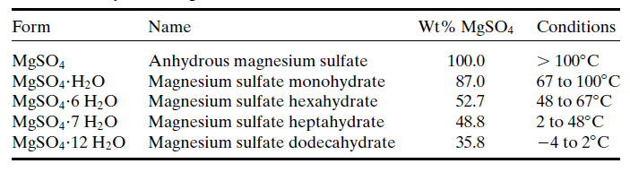
Problem 1: Crystallization
A saturated MgSO₄ solution at 130 °F is fed to a crystallizer operating at 50 °F. The solution leaving the crystallizer is saturated. Magnesium sulfate solubilities are 35 wt% MgSO₄ at 130 °F and 23 wt% MgSO₄ at 50 ° F.
Write the molecular formula for the crystalline product that forms. (See Table)
A production rate of 1000 kg/h of crystalline material is desired. Calculate (i) the required feed rate to the crystallizer (kg/h), and (ii) the rate (kg/h) at which anhydrous MgSO4 could be recovered from the crystals.

Slide 3
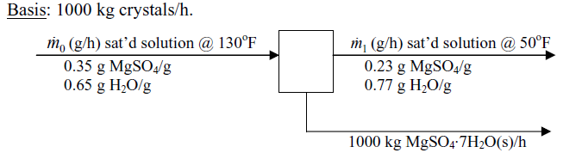
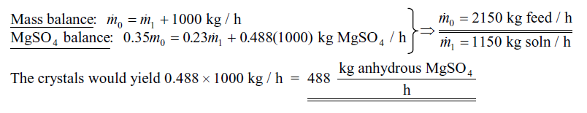
50 °F=10 °C
Salt that crystallizes is MgSO₄.7H2O, which contains 48.8 wt% MgSO44.

Slide 4
Problem 2: Distillation
One thousand kilograms per hour of a mixture containing equal parts by mass of methanol and water
is distilled. Product streams leave the top and the bottom of the distillation column. The flow rate of
the bottom stream is measured and found to be 673 kg/h, and the overhead stream is analyzed and
found to contain 96.0 wt% methanol.
Draw and label a flowchart of the process and do the degree-of-freedom analysis.
Calculate the mass and mole fractions of methanol and the molar flow rates of methanol and water in the bottom product stream.

Slide 5
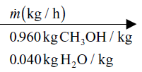
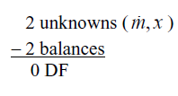
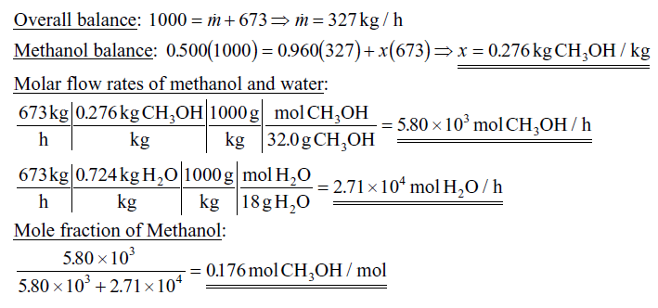
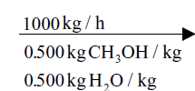
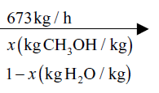

Slide 6
Problem 3: filtration
Poly-3-hydroxybutyrate (PHB) is a biodegradable thermoplastic accumulated intracellularly by many microorganisms under unfavourable growth conditions. Azotobacter chroococcum is being investigated for commercial PHB production using cheap soluble starch as the raw material and ammonia as the nitrogen source. Synthesis of PHB is observed to be growth associated with maximum production occurring when the culture is provided with limited oxygen. During steady-state continuous culture of A. chroococcum, the concentration of cell is 5 % w/w and concentration of PHB in the cells is 40% w/w. The fermentation slurry containing A.chroococcum cells is filtered using a continuous vacuum filter to recover the PHB. The inlet flow rate of slurry to the filter is 100 kg/h. Liquid filtrate is collected at a rate of 94 kg h^{-1.} Filter cake containing cells is continuously removed from the filter cloth. Drying is required to extract the PHB from cell. Drying cost is Rs. 100 to remove per kg of water from cell cake and the cost for extraction of PHB from dry cell is Rs. 80 to recover 100 gm of PHB. What would be the total downstream processing cost to recover PHB for 10000 kg slurry processing. Assume the filtration pumping cost is Rs. 20 per hr.

Slide 7

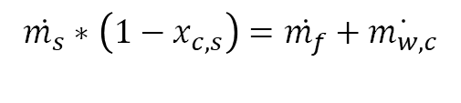
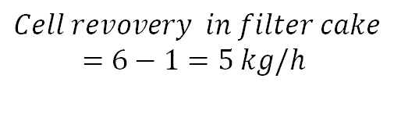














Slurry ($\dot{m_{s}}$): (cell + water)
Filtrate ($\dot{m_{f}}$): (water)
$\dot{m_{s}}$=100 g/h
$\dot{m_{f}}$=94 g/h
$${cell: x}_{c,s}=0.05$$
$PHB:\text{40\%}$ in cell (w/w)
Filter cake ($\dot{m_{c}}$): (Cell + water)
$\dot{m_{c}}$=?? g/h
$$Water: \dot{m_{w,c}}$$
$PHB:\text{40\%}$ in cell (w/w)
Total mass balance
Rate of In=Rate of out
Water mass balance
Cell mass balance
$$\dot{m_{s}}=\dot{m_{f}}+\dot{m_{c}}$$
$$\dot{m_{s}}∗\left(1−{ x}_{c,s}\right)=\dot{m_{f}}+\dot{m_{w,c}}$$
$$Cell revovery in filter cake$$
$$=6−1=5 kg/h$$
$$10=94+\dot{m_{c}}$$
$$100∗\left(1−0.05\right)=94+\dot{m_{w,c}}$$
$$\dot{m_{c}}=6 kg/h$$
$$\dot{m_{w,c}}=1 kg/h$$

Slide 8


Slurry ($\dot{m_{s}}$): (cell + water)
Filtrate ($\dot{m_{f}}$): (water)
$\dot{m_{s}}$=100 g/h
$\dot{m_{f}}$=94 g/h
$${cell: x}_{c,s}=0.05$$
$PHB:\text{40\%}$ in cell (w/w)
Filter cake ($\dot{m_{c}}$): (Cell + water)
$Water: \dot{m_{w,c}}$= 1 kg/h
$cell$= 5 kg/h
$PHB:\text{40\%}$ in cell (w/w)
Total slurry :10000 kg
Time required= 10000/100= 100 hr
Total water in cake= 1*100=100 kg
Total cell= 5*100=500 kg
Total PHB=0.4*50=200 Kg
Drying cost= Rs. 100/ kg water remove= 100*100=Rs. 10000
PHB extraction cost= Rs. 80/ 100 gm PHB = 800*200=Rs. 160000
Filtration pumping cost is Rs. 20 per hr=20*100=Rs. 2000
Total cost=Rs. 172000

